Slide 1
A Visual Data Science Solution for Visualization and Visual Analytics of Big Sequential Data
Group No - 14
Md. Sifat Kamal - 20101231
ST - Mehnaz Ara Fazal
RA - Md Sabbir Hossain
‹#›

Slide 2
Introduction
Huge volumes of big data can be generated and discovered by data science that can provide a good outcome for models like: data mining algorithm, mathematical, machine learning tools etc.
Also this analyzing and mining can give a good outcome socially
The author presented a big data visualization and visual analytics for visualizing and analyzing COVID 19 epidemiological data
Visualizes temporal trends of the sequence and findings

Slide 3
Background
For application to visualization and visual analytics many visualizers and dashboards have been developed by many notable and local organizations
Common things among them is focusing on total number of new/confirmed and death cases
Additional information and knowledge that are yet to be discover
The author prevented big data visualization and visual analytics tool for visualizing frequent patterns from the cumulative COVID 19 statistics

Slide 4
Dataset
For evaluation the author applied real life Canadian COVID 19 epidemiological dataset
Collected from Public Health Agency of Canada (PHAC)
The data are from 2020 to May 29, 2021

Slide 5
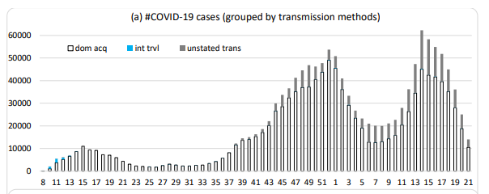
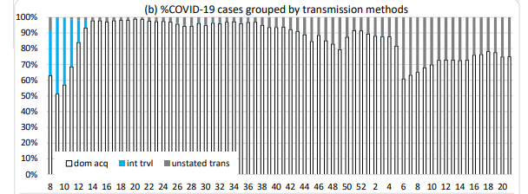
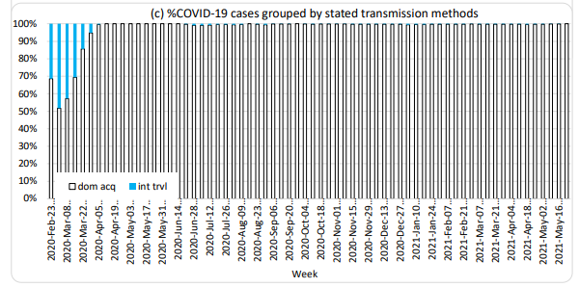
Evaluation
Figure 1: (a) absolute frequency (b) relative percentage of different transmission methods (c) relative percentage of stated transmission methods
These 3 diagrams here represent the COVID-19 cases grouped by absolute frequency, relative percentage of different transmission methods, and relative percentage of stated transmission.

Slide 6
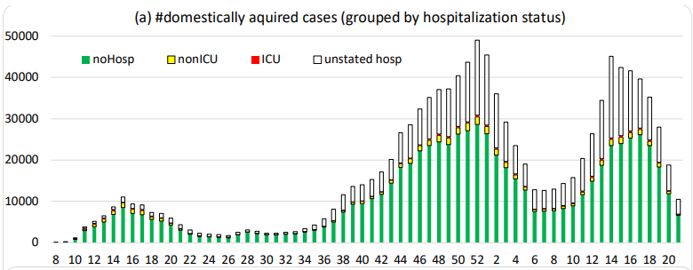
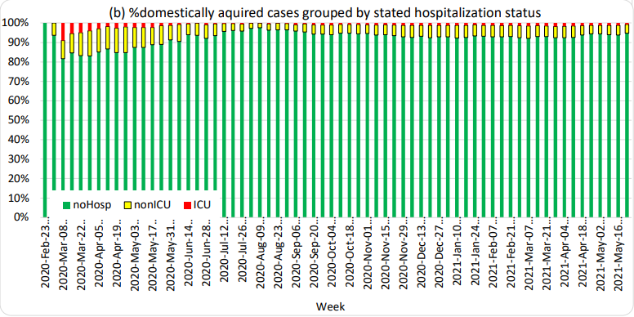
Evaluation (Continued)
Figure 2: (a) absolute frequency (b) relative percentage
Here the diagram shows the absolute frequency and relative percentage of different hospital statuses among domestic COVID19 cases

Slide 7
Future scope of improvement
Enhancing visibility
Improving interpretability
Enhancing Explainability

Slide 8
Conclusion
Presented a visual data science solution for the visualization and virtual analytics of big sequential data
The solution represents composition of combinations of feature values in stacked column
Enables easy comparison in the temporal dimension
Evaluated it by using COVID-19 data

Slide 9
Thank you

